Slide 1

Smart Home Security & Intrusion Detection
Enhancing home safety with an IoT-based system for real-time monitoring and remote access, addressing increasing security threats.

Slide 2





Introducing Our IoT Security System
Real-time Motion Detection
PIR sensors instantly detect movement, triggering immediate alerts to your devices.
ESP32 Wireless Communication
Leveraging ESP32 for robust and reliable wireless communication, ensuring constant connectivity.
User Control & Notifications
Control via keypad, web interface, Mobile app and mobile notifications from telegram for better user interaction.
Our system transcends conventional security by offering seamless real-time alerts and remote accessibility, ensuring you are always connected to your home.

Slide 3
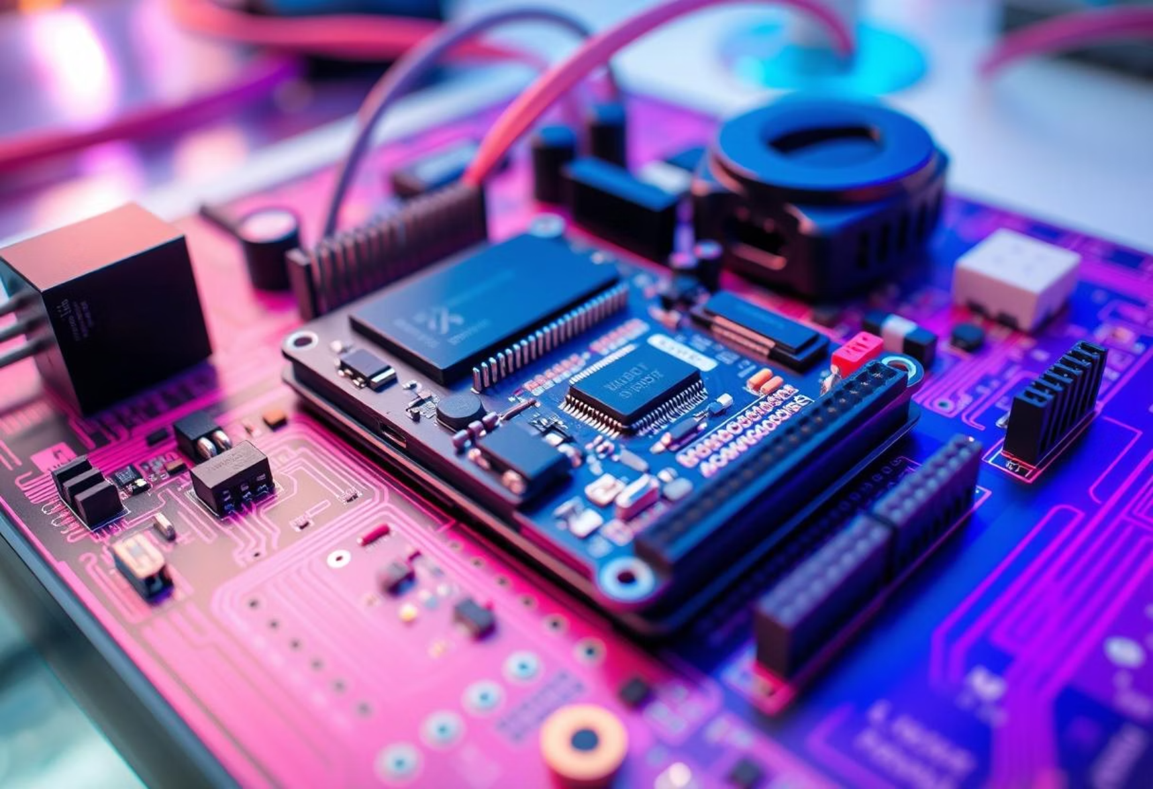

System Components
Hardware Elements
Software & Integration
ESP32 Microcontroller
Firebase for Backend Services
PIR Motion Sensor
Telegram Bot for Alerts
Keypad and Servo Motor
Blynk for Mobile Integration
LCD Display
Custom Web Application
Webcam for Image Capture
Flutter Mobile app

Slide 4

Real-time Monitoring with Blynk
Instant Motion Alerts
Receive immediate notifications on your mobile device.
Remote Door Control
Lock or unlock your doors from anywhere in the world.
Event Database Sync
All security events are logged and synced to a secure database.
Blynk integration allows seamless mobile monitoring and control, putting your home security in the palm of your hand.

Slide 5


Web Application & Firebase Integration
Secure Authentication
Firebase handles secure user login and authentication.
Real-time Status Updates
Monitor live security status and event logs via the web.
Manual System Control
Take manual control of system functionalities directly from the web.

Slide 6





Telegram Bot for Visual Verification
Motion Detected
Camera captures image upon motion detection.
Image Sent
Image is immediately sent to the user via Telegram.
User Decision
User has a limited time to accept or reject the alert.
This feature provides crucial visual confirmation, allowing users to make informed decisions regarding potential intrusions.

Slide 7

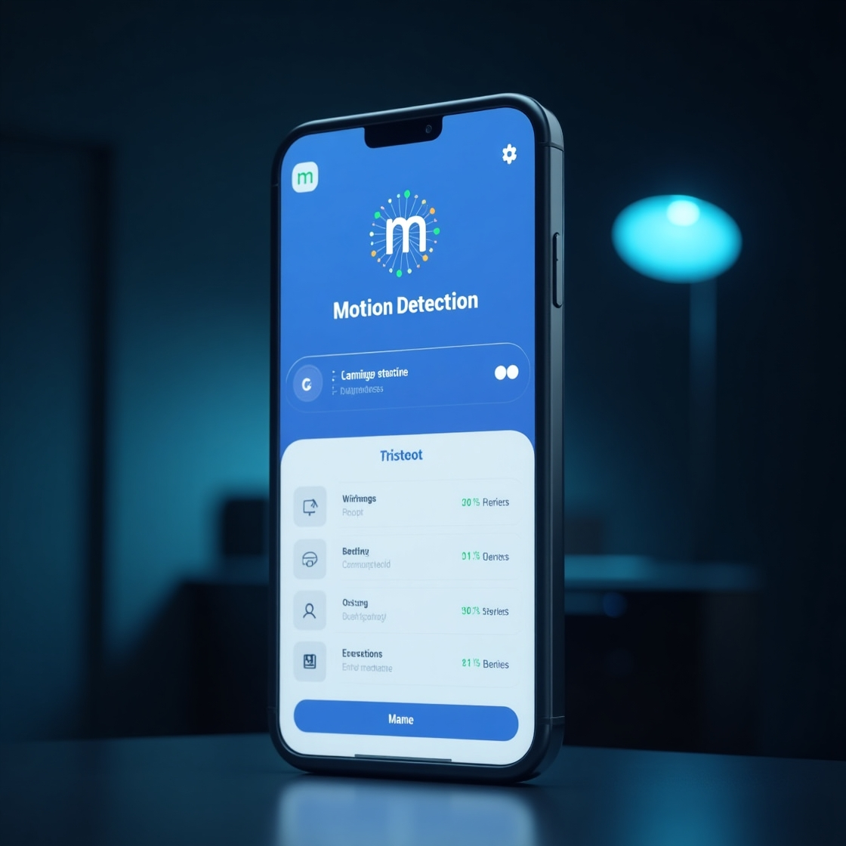
Mobile App For Motion Status Monitoring
Displays real-time motion detection status.
Connects directly with Firebase for live updates.
Simple and user-friendly interface.
Accessible anytime via smartphone

Slide 8
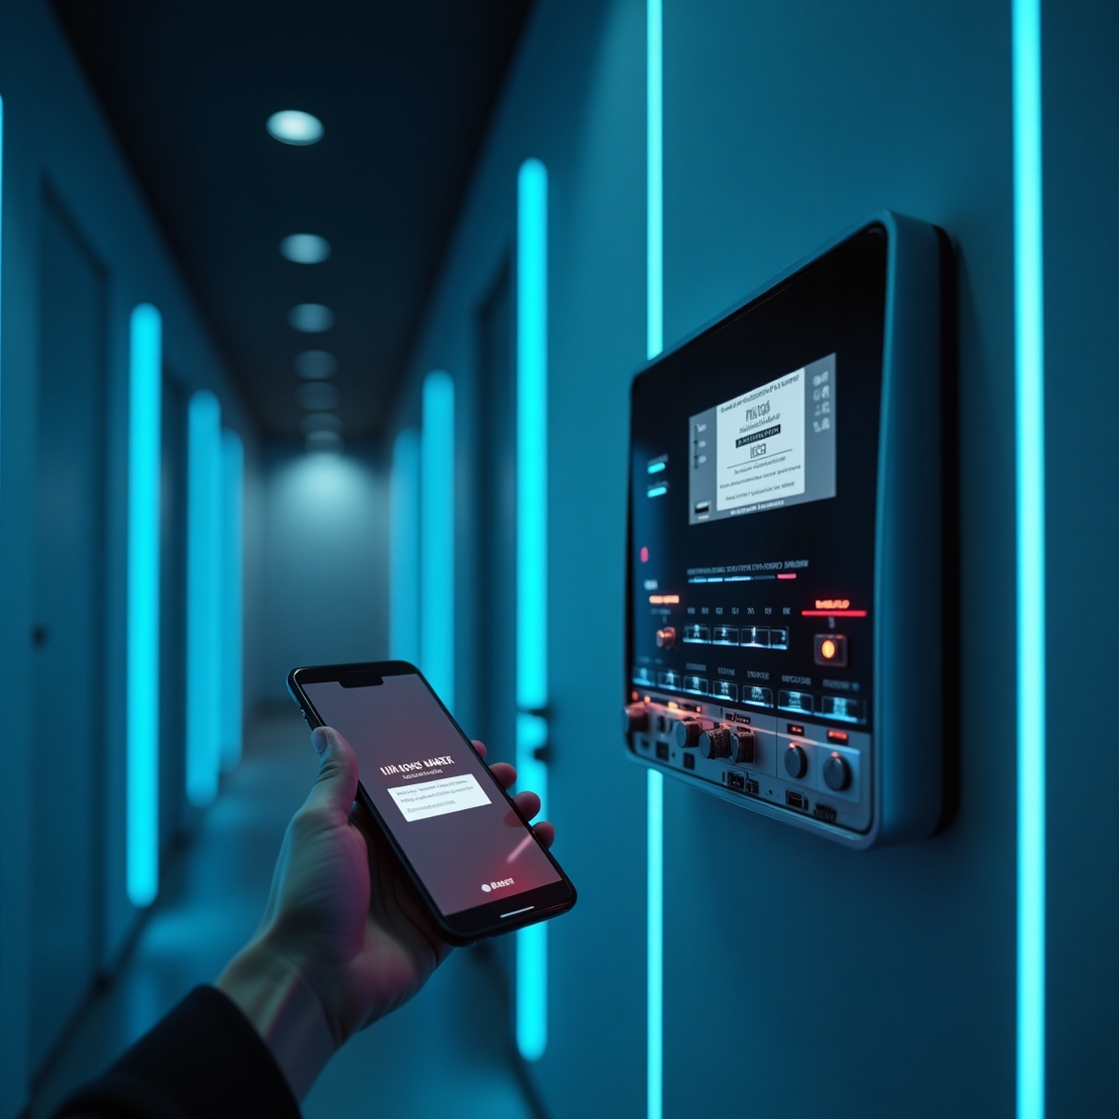
Project Simulation Modules
Core Circuit Setup
Establishing the foundational hardware connections.
Blynk Integration
Integrating Blynk for mobile alerts and remote control.
Web Application Development
Building the secure web interface for centralized control.
Telegram Visual Validation
Adding the Telegram bot for image-based verification.
Mobile App
View Status if motion detected or not

Slide 9
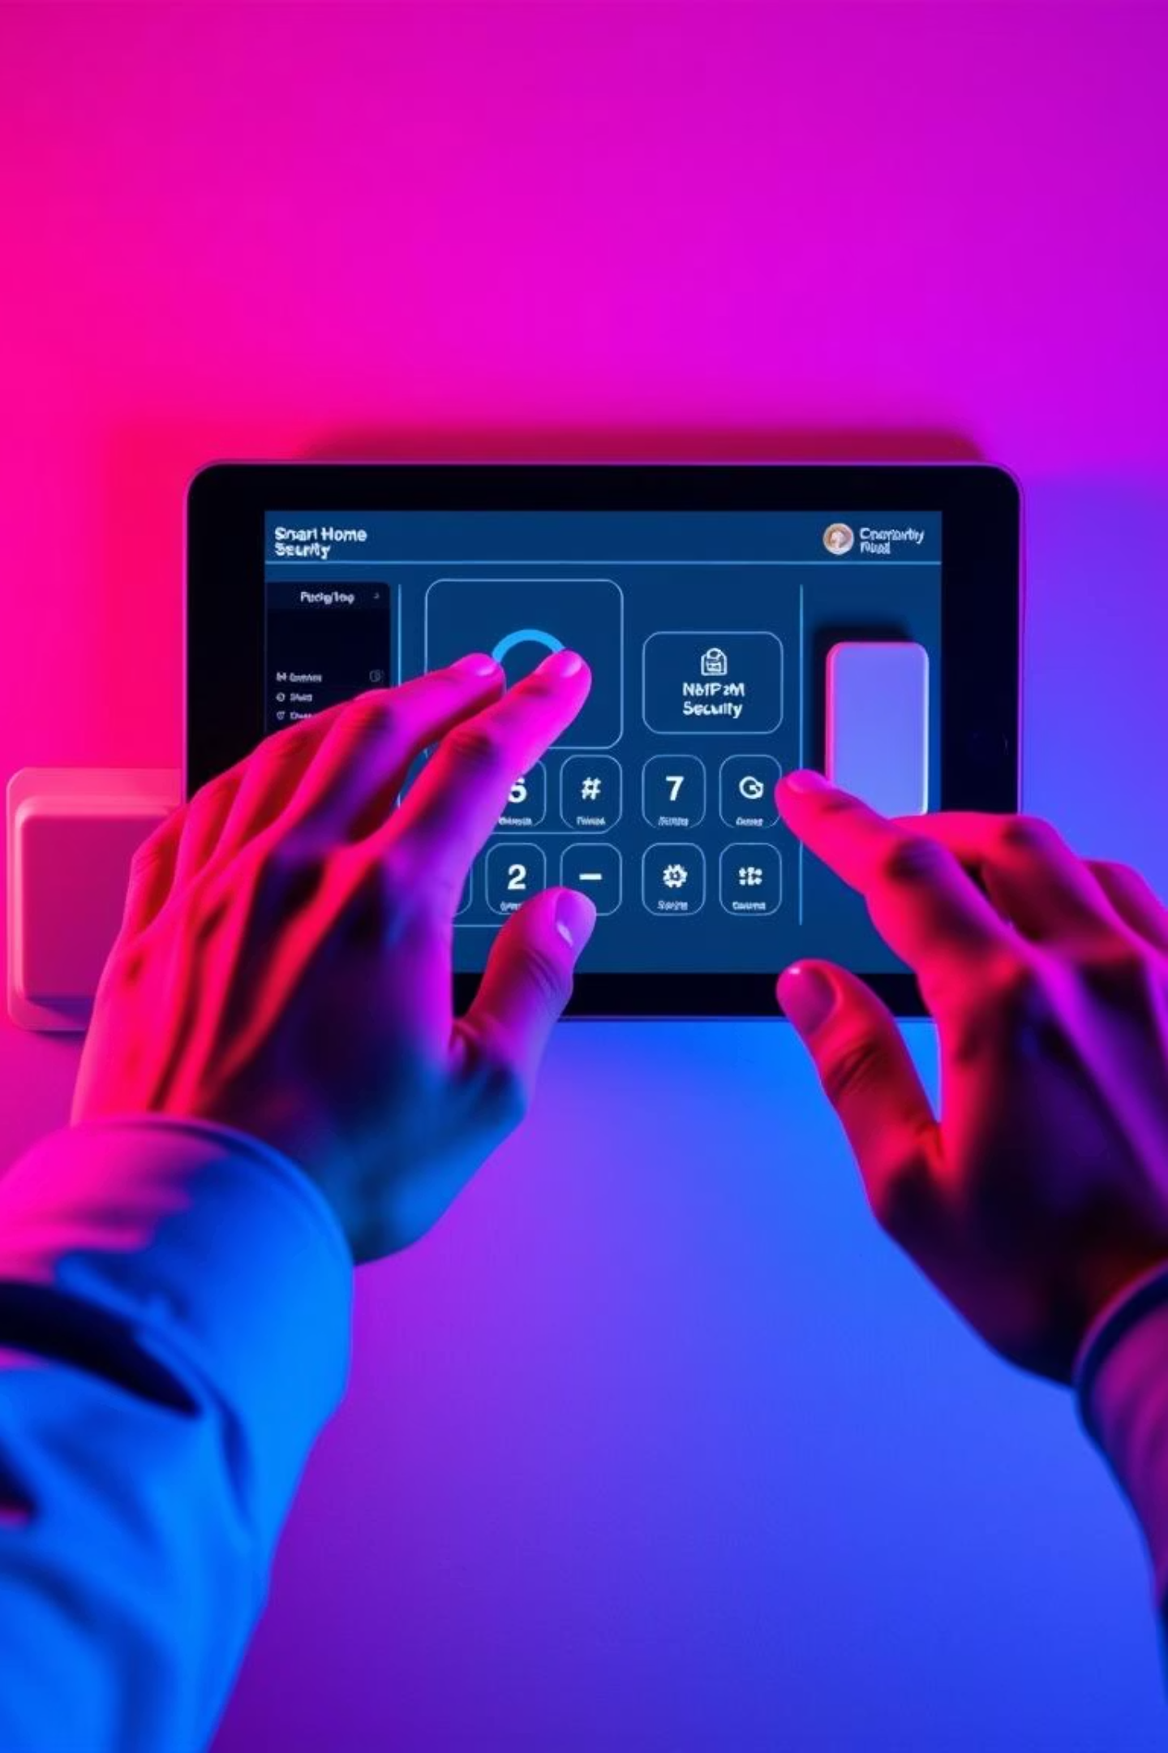
Live Demo Time
Now, let's see our Smart Home Security & Intrusion Detection system in action. Witness the real-time capabilities and seamless integration of all components.

Slide 10
Thank You!
Group Members
SEU/IS/19/ICT/017 - M.K.N Sandeepa
SEU/IS/19/ICT/053 - K.Kalindu Bawantha SEU/IS/19/ICT/058 - K.R.H.R.Kahathuduwa SEU/IS/19/ICT/061 - M.P.H.R.Aberathna

